Slide 1
Extracting Narrative Structure
Daphne Ippolito
Chris Callison-Burch
http://interactive-fiction-class.org

Slide 2
Defining Narrative
The recounting of one or more real or fictitious EVENTS communicated by one, two, or several (more or less overt) NARRATORS to one, two, or several (more or less overt) NARRATEES.
Even such possibly uninteresting texts as “The man opened the door,” “The goldfish died,” and “The glass fell on the floor” are narratives, according to this definition.
Gerald Prince – Dictionary of Narratology (1987)

Slide 3
Narrative tense
Order
Speed
Frequency
Narrative mood
Distance
Focalization
Narrative voice
Time of narrating
Narrator & narratee

Slide 4
Order
expr 1
expr 2
John eats
sandwich
John dies
expr 1
expr 2
John eats
sandwich
John dies

Slide 5
Speed
expr 3
expr 1
expr 3
expr 1
expr 2
expr 2
John eats
sandwich
John eats
sandwich
John goes outside
John goes outside
John dies
John dies
expr 1
expr 1
expr 3
expr 2
John eats
sandwich
John eats
sandwich
John goes outside
John goes outside
John dies
John dies

Slide 6
Frequency
expr 1
expr 2
John eats
sandwich
John dies
expr 1
expr 2
expr 3
expr 4
John eats
sandwich
John dies

Slide 7
Order, Speed, & Frequency
expr 1
expr 2
expr 3
King dies
Queen grieves
Queen dies
Mime
seizes
power
Jester laughs

Slide 8
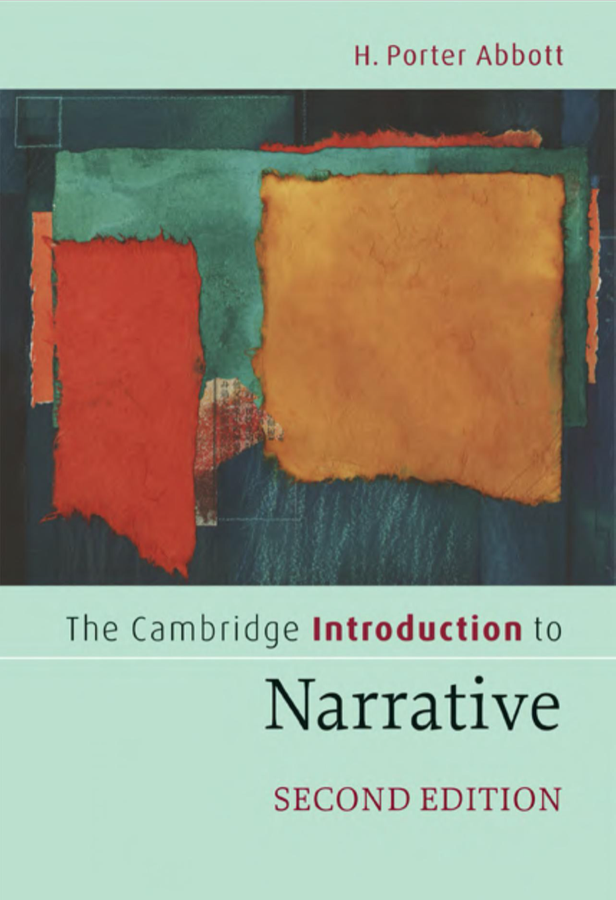
Defining Narrative
Narrative is the representation of an event or a series of events. Some definitions of narrative require 2 or more events that are causally related.
Description (no events): My dog has fleas Narrative: My dog was bitten by a flea
Notes:
﻿Simply put, narrative is the representation of an event or a series of events. “Event” is the key word here, though some people prefer the word “action.” Without an event or an action, you may have a “description,” an “exposition,” an “argument,” a “lyric,” some combination of these or something else altogether, but you won’t have a narrative. “My dog has fleas” is a description of my dog, but it is not a narrative because nothing happens. “My dog was bitten by a flea” is a narrative. It tells of an event. The event is a very small one – the bite of a flea – but that is enough to make it a narrative.
Abbott, H. Porter. The Cambridge Introduction to Narrative (Cambridge Introductions to Literature) (p. 14). Cambridge University Press. Kindle Edition.

Slide 9
Narrative discourse versus story
Story == Underlying Content
Story is an event or sequence of events (the action). Stories have:
Events
Entities / characters
Storyworld
Narrative discourse == Expression
How the story is conveyed.
Ordering of events
Focus
Person

Slide 10
Defining Narrative
Events can represented in many different ways –by a narrator, by an actor, or by paint.
The underlying events are part of the story, and the way that they are represented or conveyed is narrative discourse.

Slide 11
Ordering of events
﻿We can squeeze a day’s worth of events into one sentence:
When I woke up, I packed two loaded guns and a ski mask, drove to the bank, robbed it, and was back in time for dinner.
﻿We can tell the same story backwards and still convey the same sequence of events:
I was back in time for dinner, having robbed the bank to which I had driven with a ski mask and two loaded guns just after my nap.
Notes:
﻿We can tell the same story backwards and still convey both the timing and the chronological sequence of events:

Slide 12
Person, focus
﻿He loved that old familiar, yet always strangely new, sensation of being someone else inside his ski mask, a pistol in each hand, watching the frightened teller count out a cool million. Nothing like it to wake a guy up. Nothing like it to give him a good appetite.
Notes:
﻿We can also make many other changes in the narrative discourse and still deal with the same story. We can, for example, change the point of view (from first to third person) and expand the narrative discourse to dwell on a moment in the middle of this series of actions and still communicate with fidelity the same order of events:
Abbott, H. Porter. The Cambridge Introduction to Narrative (Cambridge Introductions to Literature) (p. 16). Cambridge University Press. Kindle Edition.

Slide 13
“Narrativity”
Tiny narratives like She drove the car to work somehow don’t feel like narratives. They lack “narrativity” or sense of someone “telling a story”.
Do we need more than one event?
She ate lunch. Then she drove the car to work.
Do we need elements like development, rising action, setting, or a recognizable narrative? We can make it feel more like a story with just one extra word.
Brooding, she ate lunch. Then she drove the car to work.
Notes:
And this may simply be because the word itself is more common to narrative than it is to ordinary discourse . Or it may be because the word gives depth to the character ( she has a mind and there is something troubling it ) .

Slide 14
Relative importance of events in a story
Constituent events are necessary for the story to be the story it is. They are the turning points, the events that drive the story forward and that lead to other events
Supplementary events are not necessary for the story. They don’t lead anywhere. If they are removed, the story will still be recognizable as the same story.

Slide 15
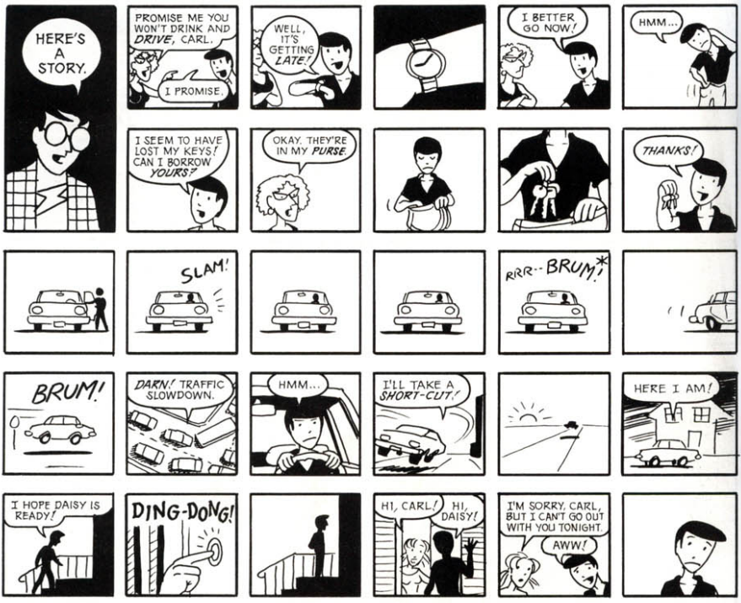

Slide 16
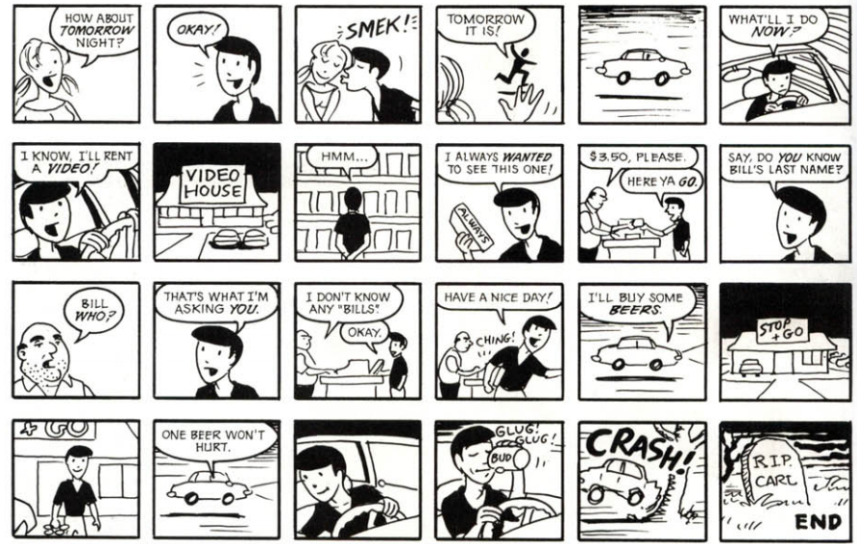

Slide 17
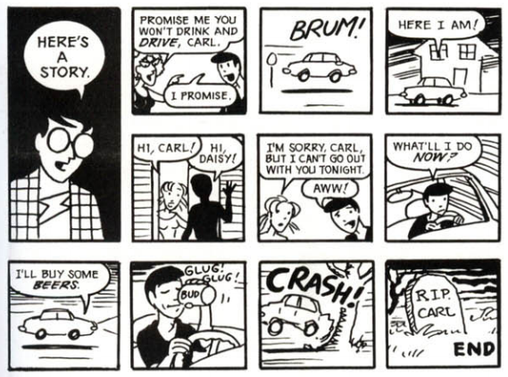

Slide 18
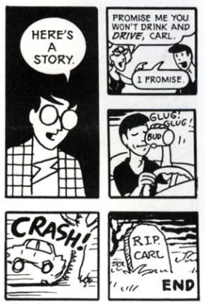

Slide 19
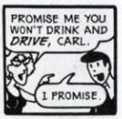
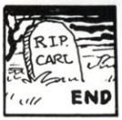

Slide 20
What to include?
Supplementary events invariably have their own impact and can carry a considerable amount of the narrative’s meaning.
They also raise an interesting question that constituent events do not:
Why were they include? Since they are not necessary to the story, why did the author feel compelled to put them into the narrative? Asking these questions is often useful in interpreting a narrative.

Slide 21
What if abstract away from expression and analyze structure across narratives?

Slide 22
Vladimir Propp
a Soviet folklorist and scholar who analyzed the basic structural elements of Russian folk tales in the 1920s to identify their simplest irreducible structural units.
Based on his analysis of 100 folktale, there were 31 basic structural elements (or 'functions') that typically occurred in fairy tales, and 7 abstract characters.

Slide 23
Notes:
1.ABSENTATION: A member of the hero's community or family leaves the security of the home environment. This may be the hero themselves, or some other relation that the hero must later rescue. This division of the cohesive family injects initial tension into the storyline. This may serve as the hero's introduction, typically portraying them as an ordinary person.
2.INTERDICTION: A forbidding edict or command is passed upon the hero ('don't go there', 'don't do this'). The hero is warned against some action.
3.VIOLATION of INTERDICTION. The prior rule is violated. Therefore, the hero did not listen to the command or forbidding edict. Whether committed by the Hero by accident or temper, a third party or a foe, this generally leads to negative consequences. The villain enters the story via this event, although not necessarily confronting the hero. They may be a lurking and manipulative presence, or might act against the hero's family in his absence.
4.RECONNAISSANCE: The villain makes an effort to attain knowledge needed to fulfill their plot. Disguises are often invoked as the villain actively probes for information, perhaps for a valuable item or to abduct someone. They may speak with a family member who innocently divulges a crucial insight. The villain may also seek out the hero in their reconnaissance, perhaps to gauge their strengths in response to learning of their special nature.
5.DELIVERY: The villain succeeds at recon and gains a lead on their intended victim. A map is often involved in some level of the event.
6.TRICKERY: The villain attempts to deceive the victim to acquire something valuable. They press further, aiming to con the protagonists and earn their trust. Sometimes the villain make little or no deception and instead ransoms one valuable thing for another.
7.COMPLICITY: The victim is fooled or forced to concede and unwittingly or unwillingly helps the villain, who is now free to access somewhere previously off-limits, like the privacy of the hero's home or a treasure vault, acting without restraint in their ploy.
8.VILLAINY or LACKING: The villain harms a family member, including but not limited to abduction, theft, spoiling crops, plundering, banishment or expulsion of one or more protagonists, murder, threatening a forced marriage, inflicting nightly torments and so on. Simultaneously or alternatively, a protagonist finds they desire or require something lacking from the home environment (potion, artifact, etc.). The villain may still be indirectly involved, perhaps fooling the family member into believing they need such an item.
9.MEDIATION: One or more of the negative factors covered above comes to the attention of the Hero, who uncovers the deceit/perceives the lacking/learns of the villainous acts that have transpired.
10.BEGINNING COUNTERACTION: The hero considers ways to resolve the issues, by seeking a needed magical item, rescuing those who are captured or otherwise thwarting the villain. This is a defining moment for the hero, one that shapes their further actions and marks the point when they begin to fit their noble mantle.
11.DEPARTURE: The hero leaves the home environment, this time with a sense of purpose. Here begins their adventure.
12.FIRST FUNCTION OF THE DONOR: The hero encounters a magical agent or helper (donor) on their path, and is tested in some manner through interrogation, combat, puzzles or more.
13.HERO'S REACTION: The hero responds to the actions of their future donor; perhaps withstanding the rigours of a test and/or failing in some manner, freeing a captive, reconciles disputing parties or otherwise performing good services. This may also be the first time the hero comes to understand the villain's skills and powers, and uses them for good.
14.RECEIPT OF A MAGICAL AGENT: The hero acquires use of a magical agent as a consequence of their good actions. This may be a directly acquired item, something located after navigating a tough environment, a good purchased or bartered with a hard-earned resource or fashioned from parts and ingredients prepared by the hero, spontaneously summoned from another world, a magical food that is consumed, or even the earned loyalty and aid of another.
15.GUIDANCE: The hero is transferred, delivered or somehow led to a vital location, perhaps related to one of the above functions such as the home of the donor or the location of the magical agent or its parts, or to the villain.
16.STRUGGLE: The hero and villain meet and engage in conflict directly, either in battle or some nature of contest.
17.BRANDING: The hero is marked in some manner, perhaps receiving a distinctive scar or granted a cosmetic item like a ring or scarf.
18.VICTORY: The villain is defeated by the hero – killed in combat, outperformed in a contest, struck when vulnerable, banished, and so on.
19.LIQUIDATION: The earlier misfortunes or issues of the story are resolved; object of search are distributed, spells broken, captives freed.
20.RETURN: The hero travels back to their home.
21.PURSUIT: The hero is pursued by some threatening adversary, who perhaps seek to capture or eat them.
22.RESCUE: The hero is saved from a chase. Something may act as an obstacle to delay the pursuer, or the hero may find or be shown a way to hide, up to and including transformation unrecognisably. The hero's life may be saved by another.
23.UNRECOGNIZED ARRIVAL: The hero arrives, whether in a location along their journey or in their destination, and is unrecognised or unacknowledged.
24.UNFOUNDED CLAIMS: A false hero presents unfounded claims or performs some other form of deceit. This may be the villain, one of the villain's underlings or an unrelated party. It may even be some form of future donor for the hero, once they've faced their actions.
25.DIFFICULT TASK: A trial is proposed to the hero – riddles, test of strength or endurance, acrobatics and other ordeals.
26.SOLUTION: The hero accomplishes a difficult task.
27.RECOGNITION: The hero is given due recognition – usually by means of their prior branding.
28.EXPOSURE: The false hero and/or villain is exposed to all and sundry.
29.TRANSFIGURATION: The hero gains a new appearance. This may reflect aging and/or the benefits of labour and health, or it may constitute a magical remembering after a limb or digit was lost (as a part of the branding or from failing a trial). Regardless, it serves to improve their looks.
30.PUNISHMENT: The villain suffers the consequences of their actions, perhaps at the hands of the hero, the avenged victims, or as a direct result of their own ploy.
31.WEDDING: The hero marries and is rewarded or promoted by the family or community, typically ascending to a throne.
Some of these functions may be inverted, such as the hero receives an artifact of power whilst still at home, thus fulfilling the donor function early. Typically such functions are negated twice, so that it must be repeated three times in Western cultures.^{[3]}

Slide 24
Notes:
1.ABSENTATION: A member of the hero's community or family leaves the security of the home environment. This may be the hero themselves, or some other relation that the hero must later rescue. This division of the cohesive family injects initial tension into the storyline. This may serve as the hero's introduction, typically portraying them as an ordinary person.
2.INTERDICTION: A forbidding edict or command is passed upon the hero ('don't go there', 'don't do this'). The hero is warned against some action.
3.VIOLATION of INTERDICTION. The prior rule is violated. Therefore, the hero did not listen to the command or forbidding edict. Whether committed by the Hero by accident or temper, a third party or a foe, this generally leads to negative consequences. The villain enters the story via this event, although not necessarily confronting the hero. They may be a lurking and manipulative presence, or might act against the hero's family in his absence.
4.RECONNAISSANCE: The villain makes an effort to attain knowledge needed to fulfill their plot. Disguises are often invoked as the villain actively probes for information, perhaps for a valuable item or to abduct someone. They may speak with a family member who innocently divulges a crucial insight. The villain may also seek out the hero in their reconnaissance, perhaps to gauge their strengths in response to learning of their special nature.
5.DELIVERY: The villain succeeds at recon and gains a lead on their intended victim. A map is often involved in some level of the event.
6.TRICKERY: The villain attempts to deceive the victim to acquire something valuable. They press further, aiming to con the protagonists and earn their trust. Sometimes the villain make little or no deception and instead ransoms one valuable thing for another.
7.COMPLICITY: The victim is fooled or forced to concede and unwittingly or unwillingly helps the villain, who is now free to access somewhere previously off-limits, like the privacy of the hero's home or a treasure vault, acting without restraint in their ploy.
8.VILLAINY or LACKING: The villain harms a family member, including but not limited to abduction, theft, spoiling crops, plundering, banishment or expulsion of one or more protagonists, murder, threatening a forced marriage, inflicting nightly torments and so on. Simultaneously or alternatively, a protagonist finds they desire or require something lacking from the home environment (potion, artifact, etc.). The villain may still be indirectly involved, perhaps fooling the family member into believing they need such an item.
9.MEDIATION: One or more of the negative factors covered above comes to the attention of the Hero, who uncovers the deceit/perceives the lacking/learns of the villainous acts that have transpired.
10.BEGINNING COUNTERACTION: The hero considers ways to resolve the issues, by seeking a needed magical item, rescuing those who are captured or otherwise thwarting the villain. This is a defining moment for the hero, one that shapes their further actions and marks the point when they begin to fit their noble mantle.
11.DEPARTURE: The hero leaves the home environment, this time with a sense of purpose. Here begins their adventure.
12.FIRST FUNCTION OF THE DONOR: The hero encounters a magical agent or helper (donor) on their path, and is tested in some manner through interrogation, combat, puzzles or more.
13.HERO'S REACTION: The hero responds to the actions of their future donor; perhaps withstanding the rigours of a test and/or failing in some manner, freeing a captive, reconciles disputing parties or otherwise performing good services. This may also be the first time the hero comes to understand the villain's skills and powers, and uses them for good.
14.RECEIPT OF A MAGICAL AGENT: The hero acquires use of a magical agent as a consequence of their good actions. This may be a directly acquired item, something located after navigating a tough environment, a good purchased or bartered with a hard-earned resource or fashioned from parts and ingredients prepared by the hero, spontaneously summoned from another world, a magical food that is consumed, or even the earned loyalty and aid of another.
15.GUIDANCE: The hero is transferred, delivered or somehow led to a vital location, perhaps related to one of the above functions such as the home of the donor or the location of the magical agent or its parts, or to the villain.
16.STRUGGLE: The hero and villain meet and engage in conflict directly, either in battle or some nature of contest.
17.BRANDING: The hero is marked in some manner, perhaps receiving a distinctive scar or granted a cosmetic item like a ring or scarf.
18.VICTORY: The villain is defeated by the hero – killed in combat, outperformed in a contest, struck when vulnerable, banished, and so on.
19.LIQUIDATION: The earlier misfortunes or issues of the story are resolved; object of search are distributed, spells broken, captives freed.
20.RETURN: The hero travels back to their home.
21.PURSUIT: The hero is pursued by some threatening adversary, who perhaps seek to capture or eat them.
22.RESCUE: The hero is saved from a chase. Something may act as an obstacle to delay the pursuer, or the hero may find or be shown a way to hide, up to and including transformation unrecognisably. The hero's life may be saved by another.
23.UNRECOGNIZED ARRIVAL: The hero arrives, whether in a location along their journey or in their destination, and is unrecognised or unacknowledged.
24.UNFOUNDED CLAIMS: A false hero presents unfounded claims or performs some other form of deceit. This may be the villain, one of the villain's underlings or an unrelated party. It may even be some form of future donor for the hero, once they've faced their actions.
25.DIFFICULT TASK: A trial is proposed to the hero – riddles, test of strength or endurance, acrobatics and other ordeals.
26.SOLUTION: The hero accomplishes a difficult task.
27.RECOGNITION: The hero is given due recognition – usually by means of their prior branding.
28.EXPOSURE: The false hero and/or villain is exposed to all and sundry.
29.TRANSFIGURATION: The hero gains a new appearance. This may reflect aging and/or the benefits of labour and health, or it may constitute a magical remembering after a limb or digit was lost (as a part of the branding or from failing a trial). Regardless, it serves to improve their looks.
30.PUNISHMENT: The villain suffers the consequences of their actions, perhaps at the hands of the hero, the avenged victims, or as a direct result of their own ploy.
31.WEDDING: The hero marries and is rewarded or promoted by the family or community, typically ascending to a throne.
Some of these functions may be inverted, such as the hero receives an artifact of power whilst still at home, thus fulfilling the donor function early. Typically such functions are negated twice, so that it must be repeated three times in Western cultures.^{[3]}

Slide 25
Joseph Campbell
Wrote a book called The Hero with a Thousand Faces (1949), in which he discusses his theory of the journey of the archetypal hero shared by world mythologies, termed the monomyth.
Notes:
https://www.youtube.com/watch?v=Hhk4N9A0oCA

Slide 26
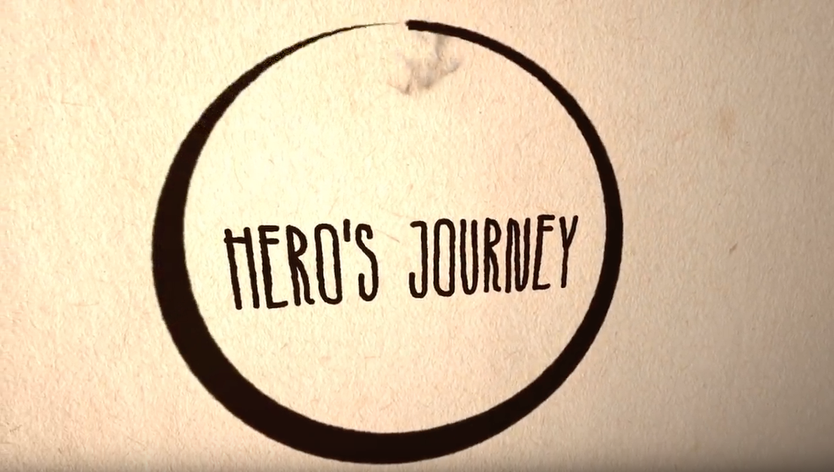
https://www.youtube.com/watch?v=Hhk4N9A0oCA
Notes:
https://www.youtube.com/watch?v=Hhk4N9A0oCA

Slide 27
Masterplots
Masterplots are stories that we tell over and over in myriad forms and that connect vitally with our deepest values, wishes, and fears. Cinderella is one of them. What is necessary for the story of Cinderella to be the story of Cinderella? Is a magical transformation of Cinderella necessary? Is the ball necessary? Is the Prince’s search for Cinderella necessary ? Is the happy ending necessary?
Works like Harry Potter and the Goblet of Fire are narratives The masterplots that underlie them are skeletal and adaptable, and they can recur in narrative after narrative . Roger Schank proposed the term “story skeleton” for something like masterplots.

Slide 28
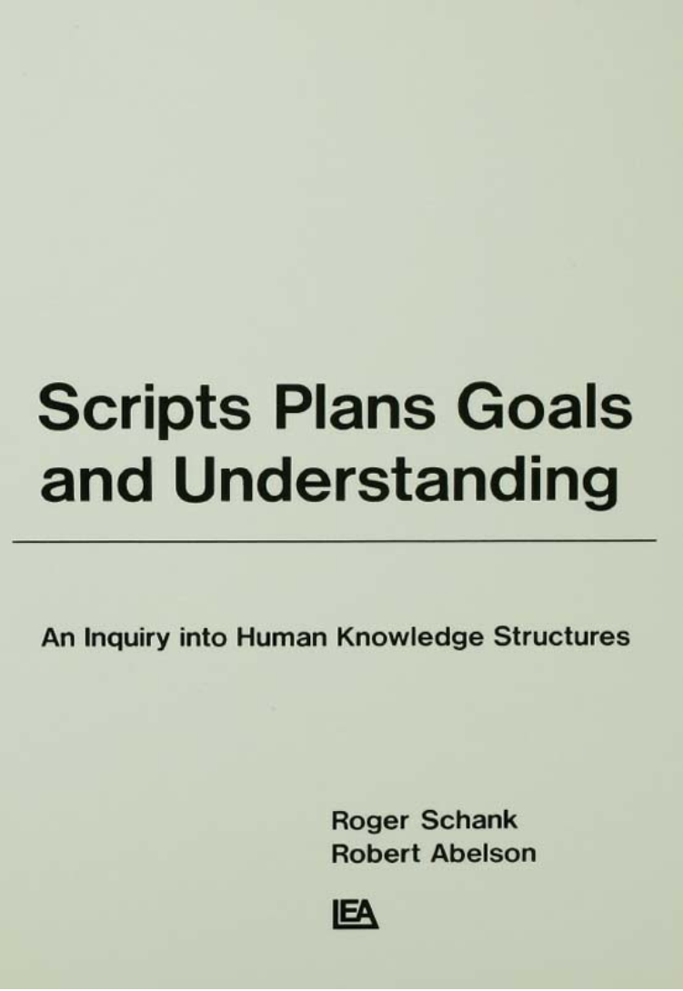
Roger Schank and Scripts
How do people organize all the knowledge they must have in order to understand? How do people know what behavior is appropriate for a particular situation?

Slide 29
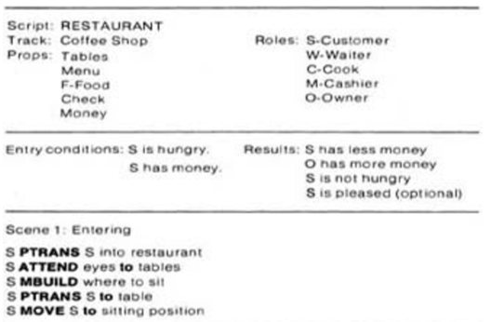
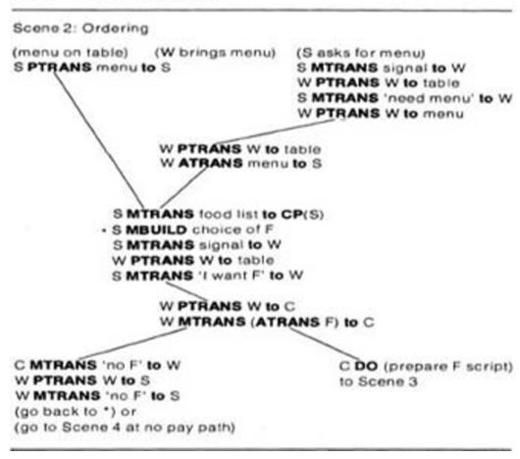

Slide 30
Can we learn scripts automatically?

Slide 31
Can we learn scripts automatically?

Slide 32
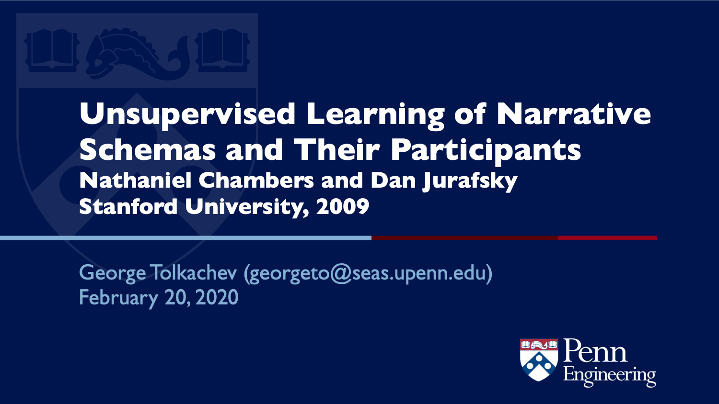
Can we learn scripts automatically?

Slide 36
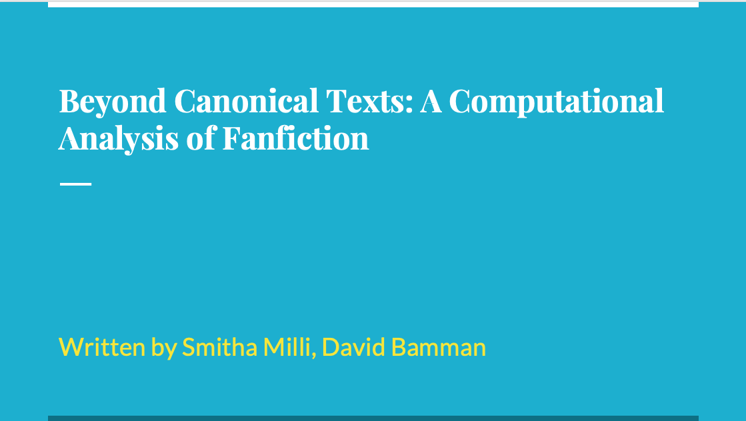
Beyond Canonical Texts: A Computational Analysis of Fanfiction
Written by Smitha Milli, David Bamman

Slide 37
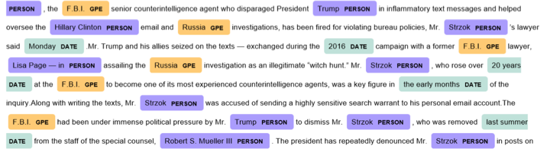
Named entity recognition
NER is a subtask of information extraction that seeks to locate and classify named entity mentioned in unstructured text into pre-defined categories such as person names, organizations, locations, medical codes, time expressions, quantities, monetary values, percentages, etc.
Notes:
Named-entity recognition (NER) (also known as entity identification, entity chunking and entity extraction) is a subtask of information extraction that seeks to locate and classify named entity mentioned in unstructured text into pre-defined categories such as person names, organizations, locations, medical codes, time expressions, quantities, monetary values, percentages, etc.
Most research on NER systems has been structured as taking an unannotated block of text, such as this one:
Jim bought 300 shares of Acme Corp. in 2006.
And producing an annotated block of text that highlights the names of entities:
[Jim]_{Person} bought 300 shares of [Acme Corp.]_{Organization} in [2006]_{Time}.
In this example, a person name consisting of one token, a two-token company name and a temporal expression have been detected and classified.
State-of-the-art NER systems for English produce near-human performance. For example, the best system entering MUC-7 scored 93.39% of F-measure while human annotators scored 97.60% and 96.95%.^{[1][2]}

Slide 38
Coreference resolution
Co-reference occurs when two or more expressions in a text refer to the same person or thing; they have the same referent, e.g. Bill said he would come; the proper noun Bill and the pronoun he refer to the same person

Slide 39
FrameNet
A semantic frame can be thought of as a conceptual structure describing an event and the participants in it.

Slide 40
Semantic Role Labeling

Slide 41
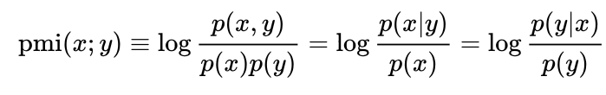
Positive Pointwise Mutual Information (PPMI)
PMI is a measure of association
Counting occurrences and co-occurrences of words in a text corpus can be used to approximate the probabilities

Slide 42
Narrative Cloze Test
A cloze test removes words from a text and asks the participant to fill in the missing language item. Cloze tests require the ability to understand context and vocabulary in order to identify the correct language or part of speech that belongs in the deleted passages. This exercise is commonly administered for the assessment of native and second language learning and instruction.
Today, I went to the ________ and bought some milk and eggs. I knew it was going to rain, but I forgot to take my ________, and ended up getting wet on the way.

Slide 43
Narrative Cloze Task
event₁ event₂ ________ event₄ … event_{L}
What word should fill in the gap?
take → nsubj
tell → nsubj
see → nsubj
…
persuade → dobj
sail → nsubj
regard → dobj
Event vocabulary

